Slide 1

Project Work Phase-1(BCS685)
Reiew-1 Presentation on
AI-Based Adaptive Interview Intelligence System
Presented By, | Under the guidance of, Hemalatha p Assistant Professor Department of CSE, EPCET
Varun B (1EP23CS177)
Tarun K S(1EP23CS167)
Rohith M(1EP23CS137)
Yashwanth Sai D(1EP23CS184)

Slide 2
INTRODUCTION
Interview preparation is an essential step for students and job seekers to succeed in recruitment processes.
Traditional interview practice methods often lack real-time feedback and objective evaluation.
With the advancement of Artificial Intelligence (AI), automated systems can simulate real interview environments.
AI technologies can analyze candidate behavior such as resume details, facial expressions, voice confidence, and answers.
The AI-Based Adaptive Interview Intelligence System conducts mock interviews and evaluates candidate performance.
It dynamically adjusts the difficulty of questions based on the candidate’s responses.
This system helps candidates improve communication skills, confidence, and technical knowledge.
AI-based interview platforms provide scalable, efficient, and unbiased evaluation for modern recruitment and training.

Slide 3
Problem Statement
Traditional interview preparation methods have several limitations:
Lack of personalized interview practice.
No real-time evaluation of candidate emotions or confidence.
Limited feedback for improving interview performance.
Human interviewers may introduce bias or inconsistency.
Because of these issues, candidates often feel nervous and unprepared during actual job interviews.
Therefore, there is a need for an AI-based system that can simulate interviews, analyze candidate behavior, and provide intelligent feedback.

Slide 4
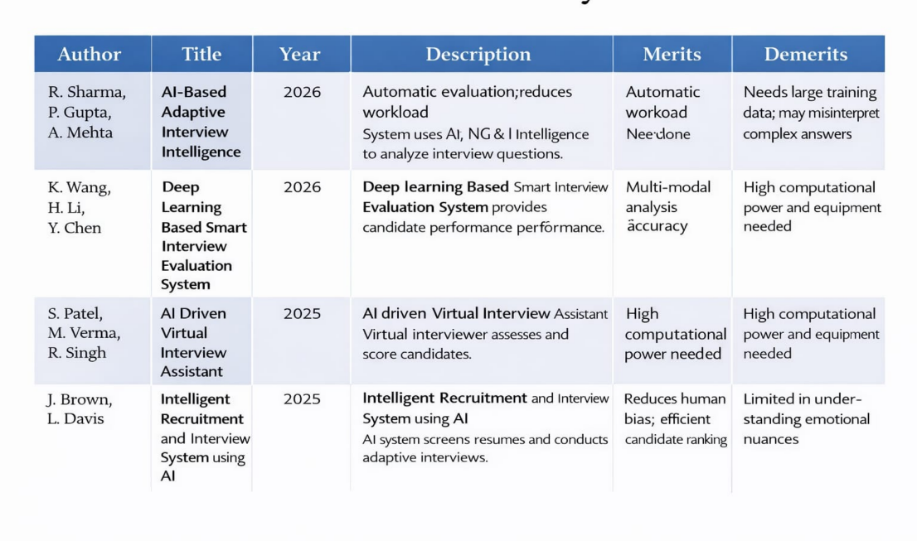
Literature Survey

Slide 5
Existing System
Current interview preparation systems mainly include:
Online interview practice platforms
Manual mock interviews
Question-based preparation websites
Limitations of existing systems:
No emotion or confidence detection.
No real-time adaptive questioning.
No interview recording for review.
Lack of intelligent feedback.
Because of these limitations, candidates cannot fully evaluate their interview performance.

Slide 6
Proposed System
The proposed system is an AI-Based Adaptive Interview Intelligence System that simulates a real interview environment.
Key features include:
Resume analysis to detect candidate skills.
AI-generated interview questions based on skills.
Real-time emotion and confidence detection using webcam and microphone.
Interview recording and replay for improvement.
Automatic termination if candidate leaves or avoids the interview repeatedly.
This system provides intelligent evaluation and personalized feedback for improving interview skills.

Slide 7
Objectives
The main objectives of the project are:
To develop an intelligent interview simulation system.
To analyze candidate skills from uploaded resumes.
To detect candidate emotions and confidence during interviews.
To dynamically adjust question difficulty based on performance.
To record and replay interviews for improvement.
To provide an objective evaluation of interview readiness.

Slide 8
System Architecture
(Show the overall structure of the system and explain each components & its interactions)

Slide 9
Hardware and Software Requirement
Hardware Requirements | Software Requirements
Computer or Laptop | Python
Webcam | Flask Frame Work
Microphone | Open CV
Minimum 8 GB RAM | Machine Learning Libraries
Internet Connection | JavaScript/HTML/CSS
 | VS code
 | JSON Datasets For Questions

Slide 10
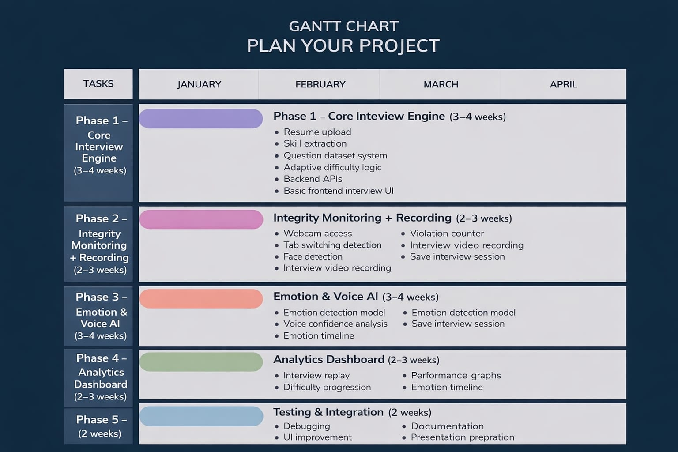
Project work Timeline

Slide 11
Conclusion
Uses NLP, LLMs, speech and emotion analysis for evaluation
Conducts dynamic and realistic behavioral interviews
Provides automated and unbiased candidate assessment
Delivers instant feedback for performance improvement
Improves efficiency, scalability, and consistency in interviews
Supports fair and data-driven recruitment processes
Contributes to the future of AI-driven hiring and interview systems

Slide 12
References
[1] Cui Kebin,Yuan Jinsha,Li Baoshu (2015) “An Auto-sorting Algorithm for Image Sequence based on Hu Vector Similarity”, Computer Engineering & Science,37(8) , pp. 1579-1583.
[2]

